Slide 1

Cells – Resize Distribute Merge and Split

Slide 2
Resize Cells
Change column width
On the Layout tab, in the Cell Size group, click in the Table Column Width box, and then specify the options you want.
On the Layout tab, in the Cell Size group, click AutoFit, and then click AutoFit Contents- only if you want to auto fit the contents

Slide 3
Resize Cells
Change row height
On the Layout tab, in the Cell Size group, click in the Table Row Height box, and then specify the height you want.

Slide 4
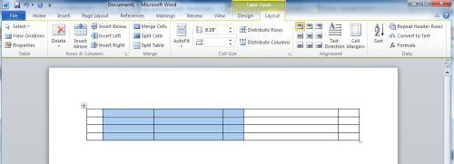
Before
After

Slide 5
Merging and Splitting
For merging 1.Select the cells that you want to merge by clicking the left edge
of a cell and then dragging across the other cells that you want
2. Under Table Tools, on the Layout tab, in the Merge group,
click Merge Cells
For splitting :
1. Under Table Tools, on the Layout tab, in the Merge group, click Split Cells.
2. Enter the number of columns or rows that you want to split the selected cells into

Slide 6
Make multiple columns or rows the same size
1.Select the columns or rows you want to make the same size.
You can press CTRL while you select to choose several sections that are not next to each other.
2.On the Layout tab, in the Cell Size group, click Distribute Columns Evenly or Distribute Rows Evenly .
TO SELECT DO THIS
The entire table In Print Layout view, rest the pointer over the table until the table move handle appears, and then click the table move handle.
A row or rows Click to the left of the row.
A column or columns Click the column's top gridline or border.
A cell Click the left edge of the cell.

Slide 7

Activity
Learner’s worksheet in DataFiles_Solutions Folder

